Slide 1

ROUND
TABLE
Eternal Business. Real Life.

Slide 2
WHO POURED
INTO YOU
AS A LEADER?

Slide 3
IS LEADERSHIP
CAUGHT
OR
TAUGHT?

Slide 4
LEADING
PEOPLE
LEADERSHIP
DEVELOPMENT
difference?
What’s the

Slide 5

BAD EXAMPLES OF LEADERSHIP
you more?
Who taught
GOOD EXAMPLES OF LEADERSHIP

Slide 6
Experience is a brutal teacher. But you learn by God, you learn.
-C.S. Lewis

Slide 7
BEST EXAMPLE OF LEADERSHIP DEVELOPMENT YOU’VE SEEN?

Slide 8

LEVELS OF
LEADERSHIP
IMPACT
IMPACT
POSITION ALONE IS THE LEAST IMPACTFUL WITHOUT THE LOWER LEVELS
LEADERSHIP
POSITION
IMPACT
WILLINGNESS TO INFLUECE
OTHERS BUILDS TRUST
INFLUENCE
OTHERS
STRONG SELF LEADERSHIP
ADDS CREDIBILITY TO
EVERYTHING YOU DO
SELF LEADERSHIP

Slide 9
LEADERSHIP LEVERAGE
SELF
LEADERSHIP
INFLUENCE
OTHERS
POSITION, INFLUENCE
& SELF LEADERSHIP
LEADERSHIP
POSITION
LOWER
LEVELS OF LEADERSHIP
CREATE LEVERAGE
& IMPACT IS MULTIPLIED
IMPACT
POSITION & INFLUENCE ONLY
IMPACT
POSITION ONLY
OPPORTUNITY

Slide 10
The biggest fallacy of good communication is the belief that it has already happened…
-unkown

Slide 11
The biggest fallacy of good communication is the belief that it has already happened…
-unkown
LEADERSHIP DEVELOPMENT

Slide 12
LEARNING
LEARNED
LEARNER

Slide 13
CHRISTIAN
DISCIPLESHIP
ARE THEY DIFFERENT? HOW ARE THEY DIFFERENT?
LEADERSHIP
DEVELOPMENT

Slide 14
GOOD
LEADER
DO YOU NEED TO BE A GOOD FOLLOWER TO BE A GOOD LEADER?
GOOD
FOLLOWER

Slide 15
ORGANIZATIONAL
LEADERSHIP
SELF/
PERSONAL
LEADERSHIP

Slide 16
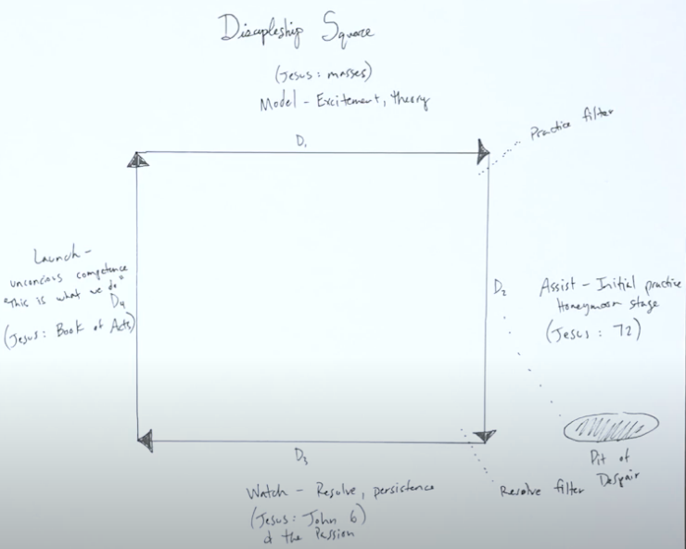
DISCIPLESHIP

Slide 17
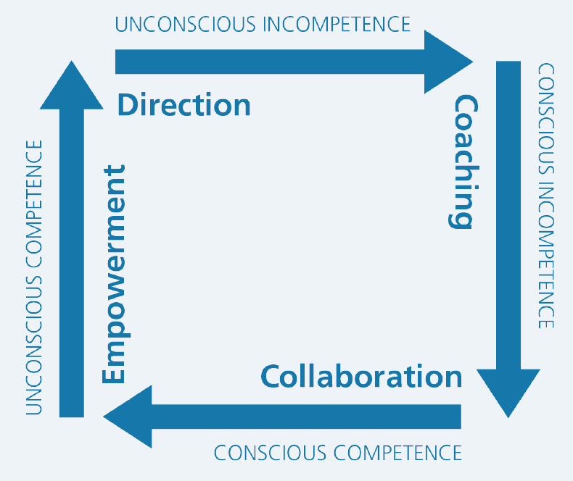
CHRIST-LIKE
LEADERSHIP DEVELOPMENT

Slide 18
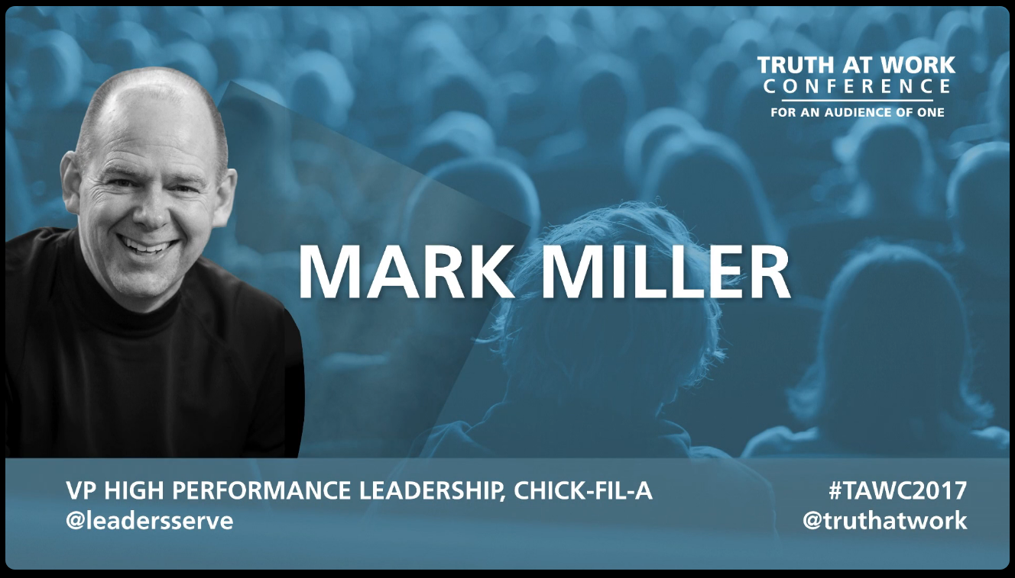
TRUTH AT WORK CONFERENCE TALK
MARK
MILLER
Chick-fil-A

Slide 19
“Quality of character doesn’t make a leader, but the lack of it flaws the entire process.”
-Peter Drucker
LEADERSHIP DEVELOPMENT

Slide 20

SKILL
CHARACTER

Slide 21
And David shepherded them with integrity of heart, and with skillful hands he led them.
Psalm 78:72

Slide 22
SKILL
…and with skillful hands he led them.
Psalm 78:72b
And David shepherded them with integrity of heart...
Psalm 78:72a
CHARACTER

Slide 23
Best time to plant a tree is 40 years ago.
The second best time is today…

Slide 24
Developing Character is best done in a process called ‘Parenting’

Slide 25
If not done in parenting, then the today is the day to start!

Slide 26

What’s on the list that ALL great Leaders do?

Slide 27
Chick-fil-A found 5 things:
1. See the Future - Vision
-Where are we going
-What are we trying to accomplish
-What are we trying to become

Slide 28
Chick-fil-A found 5 things:
2. Engage & Develop Others
-Recruit, invite, select
-Drucker: Most important decision a leader makes: “Who does what?”
-Create the culture, context, environment
-Encourage others to bring their best to work everyday

Slide 29
Chick-fil-A found 5 things:
3. Reinvent Continuously
-Progress is always preceded by change
-Hope is not a strategy

Slide 30
Chick-fil-A found 5 things:
4. Value Results & Relationship
-Jim Collins – “Genius of the &”
-Two values held in tension

Slide 31
Chick-fil-A found 5 things:
5. Embody the Values
-Walk the talk
-Share them, know them, articulate them, live them
-People are looking for what’s important, do we care about them, are we trustworthy?
-People don’t expect perfection just effort

Slide 32
The Secret

