Slide 1
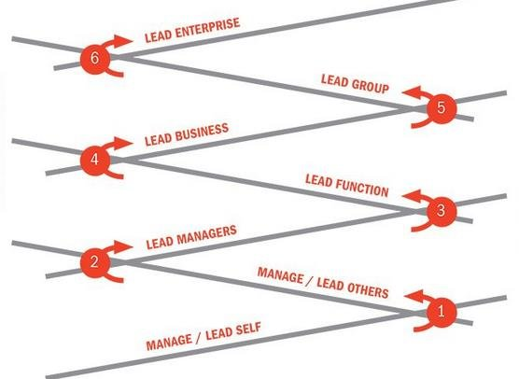
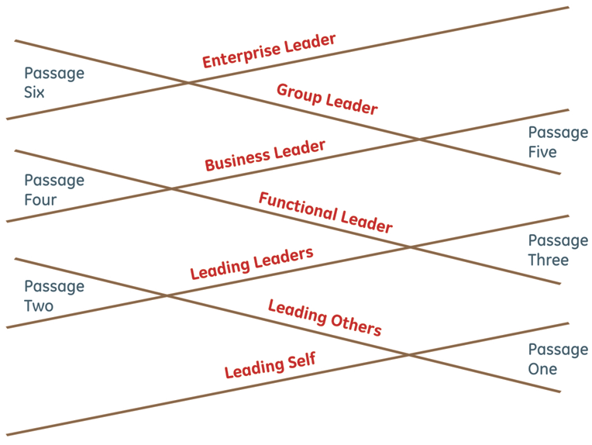
The Leadership Pipeline
See Notes View Below
Notes:
One tool I utilize often with leadership teams I am coaching and used it in my business a number of times, was taken from The Leadership Pipeline by Charan and Drotter. It iis one of the best models for developing leaders at every level in your organization. Here is a summary of some key takeaways:
Helps you understand what you need to master at each level
Helps you understand how your time should be spent at each level
Great tool for helping you developing people on your team showing them what they need to do to develop to the next level
Great tool for coaching people who think they should be at the next level and haven’t mastered it yet
It also demonstrates how, if you skip a step or don’t develop well enough at one level in will eventually catch to you at the higher levels of leadership.
NOTICE THE FIRST STEP IS LEADING SELF. If you can’t do this well it will be hard for you to lead others.

